Slide 1
DermAI: Intelligent Skin Disease Detection System
CSE7301 Project
Final Review
Batch Number: CSD G-14
Roll Number | Student Name
Under the Supervision of,
Dr. Srabana Pramanik
Assistant Professor (Senior Scale)
School of Computer Science and Engineering
Presidency University
20211CSD0002 | Venessa Gwendolyn
20211CSD0158 | Veluru Hitha
20211CSD0082 | Nisarga B.M.
20211CSD0028 | Vibha Swamy
20211CSD0010 | Leena Zawahir
Name of the Program: B.Tech Computer Science Engineering ( Data Science)
Name of the HoD: Dr. Saira Banu Atham
Name of the Program Project Coordinator: Dr. Manjula HM
Name of the School Project Coordinators: Dr. Sampath A K / Mr. Md Ziaur Rahman

Slide 2
Introduction
The project focuses on automating skin disease classification using deep learning techniques.
It aims to enhance diagnostic accuracy and reduce reliance on dermatologists, making early detection more accessible.
By leveraging AI, the system can assist in remote healthcare solutions, benefiting areas with limited medical facilities.
The model helps in cost-effective and timely diagnosis, potentially reducing the burden on healthcare systems.
This innovation bridges the gap in dermatological care, ensuring better patient outcomes and faster treatment initiation.

Slide 3
Literature Review
Machine Learning for Skin Disease Detection – Vayadande (2024) presents various machine learning techniques for identifying skin diseases, focusing on enhancing diagnostic accuracy and reducing human error. The study highlights the importance of automated systems in improving early detection and treatment outcomes.
Deep Learning-Based Classification – Suresh et al. (2024) investigate the role of deep learning models, particularly CNNs, in classifying skin diseases with high precision. The research emphasizes the effectiveness of AI-driven decision support systems in dermatology, improving diagnostic efficiency and accessibility.

Slide 4
Existing method Drawback
Limited Dataset Generalization – Many existing machine learning models struggle with generalizing across diverse skin tones and rare diseases due to biased or insufficient datasets, leading to inaccurate predictions.
High Dependency on Data Quality – Deep learning models require large, high-quality annotated datasets, but obtaining and labeling medical images is time-consuming and expensive, limiting model performance.
Lack of Explainability – Most AI-driven skin disease detection models operate as black boxes, making it difficult for dermatologists to interpret predictions and trust AI-based decisions.
Computational Complexity – Advanced deep learning models demand high computational power, making real-time diagnosis challenging, especially in resource-limited healthcare settings.

Slide 5
Proposed Method
Category (Hardware / Software / Both) : Software
Problem Description: To develop an automated system that can accurately detect skin diseases from images of skin lesions using deep learning algorithms. This system will leverage advanced image processing and machine learning techniques to classify skin conditions, potentially identifying various types of skin diseases such as melanoma, basal cell carcinoma, and psoriasis, among others.
Difficulty Level: Complicated
Problem Statement Number: PSCS67

Slide 6
Objectives
Develop an Accurate Classification Model – Build a deep learning-based system for precise skin disease detection and classification.
Enhance Model Generalization – Ensure robust performance across diverse skin tones, lighting conditions, and disease variations.
Improve Explainability – Integrate explainable AI techniques to provide transparent and interpretable predictions for dermatologists.
Optimize Computational Efficiency – Design a lightweight yet powerful model for faster diagnosis with minimal hardware requirements.
Increase Accessibility – Deploy the system on cloud and edge devices for real-time skin disease detection in remote and resource-limited areas.

Slide 7
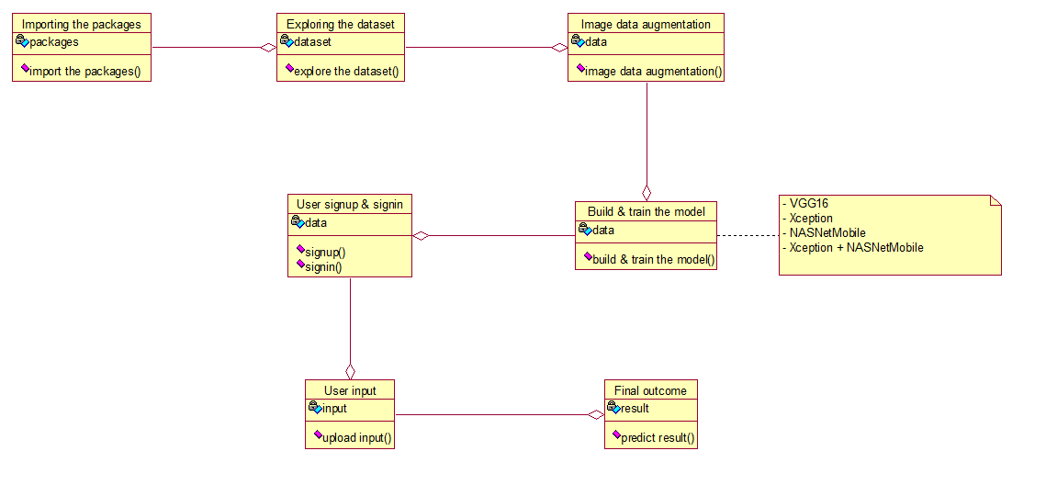
Methodology/Modules

Slide 8
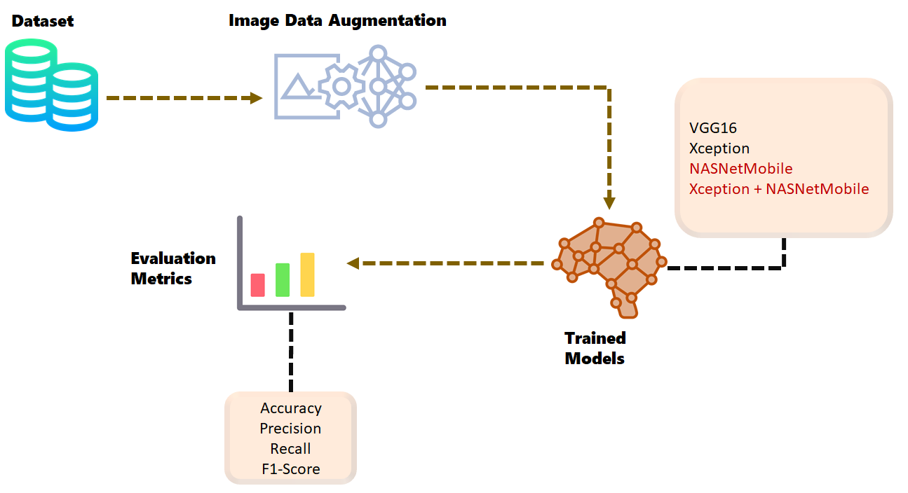
Architecture

Slide 9
Hardware/software components
SOFTWARE REQUIREMENTS
1) Software: Anaconda
2) Primary Language: Python
3) Frontend Framework: Flask
4) Back-end Framework: Jupyter Notebook
5) Front-End Technologies: HTML, CSS, JavaScript and Bootstrap4
HARDWARE REQUIREMENTS
1) Operating System: Windows Only
2) Processor: i5 and above
3) Ram: 8GB and above
4) Hard Disk: 25 GB in local drive

Slide 10
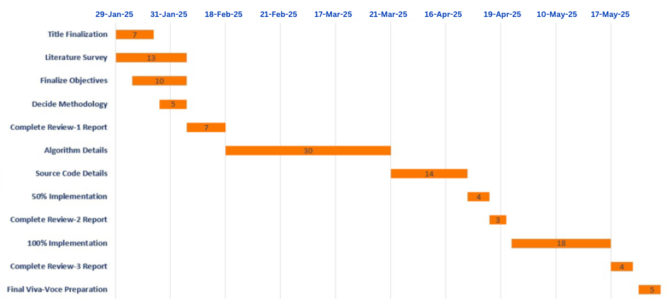
Timeline of the Project (Gantt Chart)

Slide 11
Expected Outcomes
Accurate Skin Disease Prediction The web application will provide reliable and real-time classification of uploaded skin images into six categories using a pre-trained deep learning model, aiding early identification and potential intervention.
User-Friendly Web Interface A clean, intuitive Flask-based interface will allow users to easily upload images, register/login securely, and view results — making advanced diagnostics accessible to non-technical users.
OTP-Based Secure Authentication System The project includes a working user authentication mechanism with OTP verification via email, ensuring secure signup and login procedures to protect user data.
Deployable Medical AI Prototype The final outcome is a functional, portable prototype that can be further enhanced or deployed to cloud platforms, serving as a base for AI-assisted teledermatology or remote diagnostics tools.

Slide 12
Conclusion
This study presents an efficient deep learning approach for automated skin disease detection, addressing the limitations of existing manual and rule-based methods. By leveraging deep learning models, explainability techniques, and real-time deployment, the proposed system enhances diagnostic accuracy, accessibility, and clinical decision support. Future improvements can focus on expanding datasets, improving model generalization, and integrating multi-modal diagnostic features for even more reliable skin disease classification

Slide 13
Github Link
The Github link provided have public access permission.
Github Link

Slide 14
References
[1] R. K. Ahalya, G. Babu, S. Sathish and K. Shruthi, "Automated Skin Disease Detection Using Deep Learning Algorithms," 2024 10th International Conference on Communication and Signal Processing (ICCSP), Melmaruvathur, India, 2024, pp. 481-486, doi: 10.1109/ICCSP60870.2024.10543405.
[2] A. Harbola, N. Danu, D. Negi, A. Gupta, A. Joshi, and R. Negi, “Unveiling Dermatology: A Deep Learning Approach for Skin Disease Detection Using Convolutional Neural Network,” in Advances in Intelligent Systems and Computing, Taylor & Francis, 2024
[3] M. Badr, A. Elkasaby, and M. Alrahmawy, “A Multi-model Deep Learning Architecture for Diagnosing Multi-class Skin Diseases,” J. Digit. Imaging. Inform. Med., 2024. doi: 10.1007/s10278-024-01300-w

Slide 15
[4] S. Javaid and M. T. Ubaid, “Skin Disease Detection Using Transfer Learning,” in Proceedings of the 2024 International Visualization, Informatics and Technology Conference (IVIT), Kuala Lumpur, Malaysia, 2024, pp. 122–127. doi: 10.1109/IVIT62102.2024.10692509.
[5] V. Sharma and S. Mehta, "Deep Neural Networks for Dermatology: CNN-GAN in Multi Class Skin Disease Detection," 2024 5th International Conference on Electronics and Sustainable Communication Systems (ICESC), Coimbatore, India, 2024, pp. 985-990, doi: 10.1109/ICESC60852.2024.10689851

Slide 16
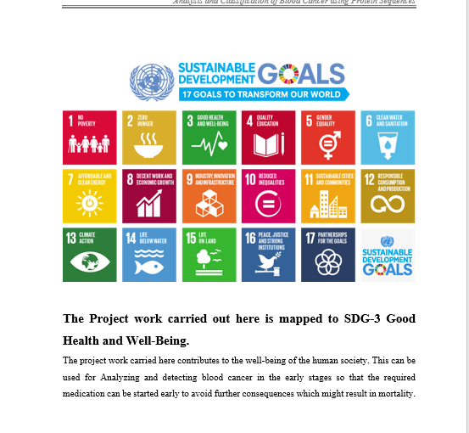
Project work mapping with SDG

Slide 17
SDG 3: Good Health and Well-being 🏥
Your AI-driven skin disease detection enables early diagnosis and accurate treatment, improving healthcare accessibility and reducing misdiagnosis. It supports telemedicine and remote healthcare, ensuring better medical outcomes.
SDG 9: Industry, Innovation, and Infrastructure ⚙️
By integrating deep learning into dermatology, your project fosters technological advancements in healthcare. It promotes AI-driven innovation, scalability, and cost-effective medical solutions.
SDG 10: Reduced Inequalities 🌍
Your AI model provides affordable and accessible skin disease diagnosis, helping underserved communities. It ensures equal healthcare opportunities by bridging gaps in dermatological care.

Slide 18


